Slide 1


RISE KRISHNA SAI PRAKASAM GROUP OF INSTITUTIONS
Department of Electronics and communications Engineering
A REAL TIME IMPLEMENTATION OF DATA HIDING IN AUDIO FOR MILITARY APPLICATIONS
Ch .Naga chaitanya (218A1A0442)
A . Nithin (218A1A0438)
B. Harith kumar reddy (218A1A0439)
Ch .Hemanth kumar reddy (218A1A0440)
PROJECT GUIDE
Miss V. V. Narayanamma , M. Tech ,
Asst Professor
Dept. of ECE

Slide 2
CONTENTS:-
ABSTRACT
INTRODUCTION
OBJECTIVE
SOFTWARE AND HARDWARE REQUIREMENTS
EXISTING SYSTEM
DRAWBACKS
PROPOSED SYSTEM
CONCLUSION
REFERENCES

Slide 3
Abstract
In this paper we propose Secret communication through Audio with Textual Information using Steganography method. Steganography is an art of sending hidden data or secret messages over a public channel so that a third party cannot detect the presence of the secret messages. The goal of steganography is different from classical encryption, which seeks to conceal the content of secret messages; steganography is about hiding the very existence of the secret messages. Modern steganography is generally understood to deal with electronic media rather than physical objects. There have been numerous proposals for protocols to hide data in channels containing pictures, video, audio and even typeset text. This makes sense for a number of reasons.

Slide 4
Introduction
In today's digital landscape, the secure transmission of sensitive information is paramount, especially in military operations where information can be a critical asset. Traditional encryption methods, while effective, can sometimes reveal the existence of hidden information to potential adversaries. As a result, there has been growing interest in steganography—the practice of concealing data within other forms of media, such as images, videos, or audio signals.
The advantage of steganography, over cryptography alone, is that messages do not attract attention to themselves. Plainly visible encrypted messages—no matter how unbreakable—will arouse suspicion, and may in themselves be incriminating in countries where encryption is illegal. Therefore, whereas cryptography protects the contents of a message, steganography can be said to protect both messages and communicating parties.

Slide 5
Data hiding types:
This project is used to secure communication between transmitter and receiver that not hack the third party by using real time audio data hiding technology in defencive or military application.
Data hides the information with the help of duplicate application.
Data hiding are two types:
(1) Visible data hiding
(2) Invisible data hiding
Visible data hiding : To display both duplicate information and secret information. This technology are used for publicity purpose.

Slide 6
EX: college records
Online question papers
Some Google technology.
(2)Invisible data hiding: To display only duplicate information to hide the secret information. This technology is used in security applications .
EX: Politics
Education system
Bank system
Satellite communication system.

Slide 7
Invisible data hiding types:
Stegnography: It is defined as stegno which means similar and graphy means process. It is similar process.
EX: Earphones.
(2) Cryptography: It is defined as crypto which means heterogeneous and graphy means process. It is different process.
EX: QR Code.
(3)Water Marking: It is defined as marking at a particular specific point.

Slide 8
Modified cryptography types:
(1)Image Cryptography: It shows the process of forming image to image and image to text process.
(2)Audio Cryptography: It shows the process of forming audio to audio and audio to text process.
(3)Video Cryptography: It shows the process of forming video to video, video to image and video to text process.
Here our project based on audio cryptography.

Slide 9
Problem statement
In the digital era, secure communication is critical for sensitive fields like banking, military, and e-commerce. Traditional encryption methods can be vulnerable to detection, prompting the need for data-hiding techniques. Steganography offers a solution by embedding secret information within innocent carrier files like images or audio. This project focuses on advancing steganography techniques to minimize detection risks and enhance data protection for security-sensitive applications.

Slide 10
Objective
The objective of implementing real-time data hiding in audio for military applications is to develop a robust and secure method for transmitting sensitive information covertly within audio files, ensuring that the hidden data remains undetectable by unauthorized parties. This system should maintain the audio file's quality and usability, while allowing the embedded data to withstand various attacks or manipulations.

Slide 11
SOFTWARE REQUIREMENTS:-
Operating system : Windows 11
Coding Language : MATLAB
Tool : MATLAB R 20013 8.10
HARDWARE REQUIREMENTS:-
System : Pentium IV 2.4 GHz
Hard Disk : 456 GB
Floppy Drive : 1.44 Mb
Monitor : 14.6 VGA colour
Ram : 8GB

Slide 12
Existing Method
Cryptography hides secret data within carrier files like images or audio, ensuring covert communication and confidentiality. Unlike encryption, it avoids detection, making it ideal for military, cybersecurity, law enforcement, and finance. Techniques include manipulating image pixels or embedding data in sound. The main challenges are preserving carrier quality and preventing detection by steganalysis. Cryptography is the art or study of hiding information by inserting secret messages in other messages. Medium where information is inserted can be anything. This medium is called the cover object. Cryptography that is applied to hide information on the cover of digital objects is called Digital Cryptography. Cover objects that are used in digital cryptography can vary, for example in the image archive.

Slide 13
Flow chart of existing method
Encrypted Information
Information
Encryption
Key Generator
Public Key

Slide 14
Explanation of Flow chart
Information: Raw data needing protection, called plaintext before encryption, includes text, audio, or video.
Encryption: Encryption converts plaintext into unreadable ciphertext, ensuring confidentiality using algorithms like symmetric (AES) or asymmetric (RSA) methods.
Encrypted Information: Ciphertext, the output of encryption, is a random sequence decipherable only with the correct decryption key.

Slide 15
Key Generator: A key generator creates cryptographic keys—one key for symmetric encryption or a public-private key pair for asymmetric encryption—using random or pseudorandom number generators to ensure security.
Public Key: A public key is used for encryption, works with a private key for decryption, and includes a modulus and an exponent in RSA. Public key encryption is the most secure type of steganography. It also has multiple levels of security in that unwanted parties must first suspect the use of steganography and then they would have to find a way to crack the algorithm used by the public key system before they could intercept the secret message.

Slide 16
Flow chart of existing method
Encrypted Information
Decryption
Information
Key Remover
Public Key

Slide 17
Explanation of Flow chart
Encrypted Information: Ciphertext, the output of encryption, is a random sequence decipherable only with the correct decryption key.
Decryption: Decryption converts encrypted data back to its original form using a key, ensuring secure access.
Information: Raw data needing protection, called plaintext before encryption, includes text, audio, or video.

Slide 18
Key Remover: A key remover is a tool or method used to extract, disable, or bypass keys in cryptographic systems, software licensing, or physical locks. Its use must adhere to legal and ethical standards.
Public Key: A public key is used for encryption, works with a private key for decryption, and includes a modulus and an exponent in RSA. It also has multiple levels of security in that unwanted parties must first suspect the use of steganography and then they would have to find a way to crack the algorithm used by the public key system before they could intercept the secret message.

Slide 19
Drawbacks:
Transmission time for document encrypted using public key cryptography is significantly slower, in face transmission of very large documents is prohibitive.
The key sizes must be significantly large to achieve the high level of protection
Public key cryptography is susceptiable to impersonation affects.
EX:- Mobile assignments

Slide 20
Proposed System:
LSB audio steganography hides secret information by modifying the least significant bits of audio samples, which minimally alters the audio quality. The secret message is converted to binary, embedded in the LSBs, and the modified file is saved. To extract the message, the LSBs are retrieved, converted back to binary, and decoded. This method allows covert communication and watermarking with minimal audio degradation but has limitations in data capacity and security.

Slide 21
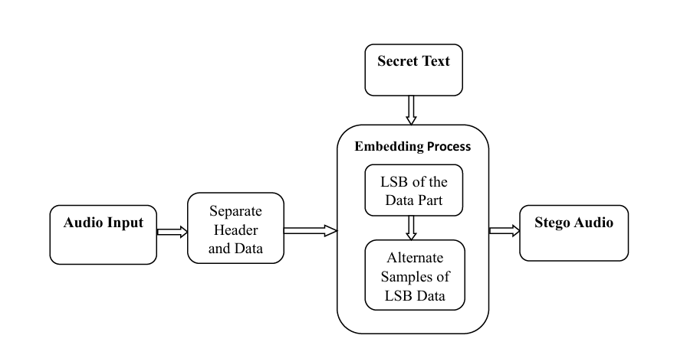
Flow chart of proposed system

Slide 22
Explanation of Flow chart
Audio Input: The audio input is the original file used as the cover medium, consisting of a header (metadata) and audio sample data.
Separate Header and data: The audio file is split into a header, containing metadata left unchanged, and a data section used for embedding the secret text.
Secret Text: The secret text, representing sensitive information, is converted into binary form before being embedded into the audio data.

Slide 23
Embedding Process: The embedding process hides the binary secret text in the Least Significant Bits (LSB) of the audio data by modifying alternate samples to enhance security and minimize impact on audio quality.
Stego Audio: The stego audio, created by combining the original audio header with modified data, contains the hidden secret text while remaining indistinguishable from the original.

Slide 24
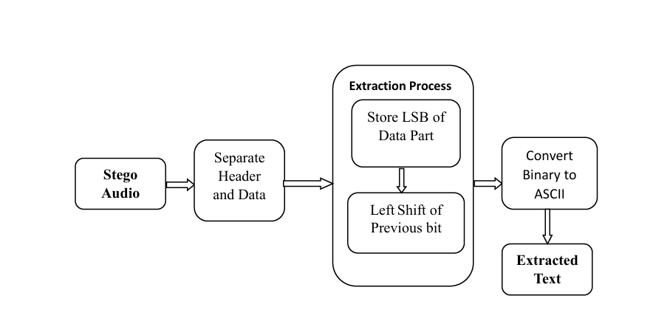
Flow chart of proposed system

Slide 25
Explanation of Flow chart
Stego Audio: The stego audio is the input file containing the hidden secret text embedded within the modified audio data.
Separate Header and Data: The stego audio is divided into a header containing metadata and a data section with audio samples where the hidden binary data is embedded.
Extraction Process:The LSBs of each audio sample are extracted and sequentially shifted left to reconstruct the hidden message, ensuring the binary data is correctly aligned for decoding.

Slide 26
Convert Binary to ASCII:The aligned binary data is converted into ASCII characters by mapping each 8-bit chunk to a character, reconstructing the original secret message.
Extracted Text: The hidden message is successfully decoded and can now be used or interpreted as plain text.

Slide 27
Conclusion
A method of embedding text-based data into a host audio file using the method of bit modification has been presented in this paper. A procedure has been developed in which the data field is edited to embed intended data into the audio file. To proceed with this, the header section of the audio has been checked perfectly because a minimal change in the header section may leads to a corruption of whole audio file.
In this algorithm, as an experiment first 50 bytes have been left untouched and starting from the 51st bytes every alternate sample has been modified to embed textual information. However a rough study was made to see how the changing of a specific bit field creates degradation in the host audio file and in which point it leads to perceptible change in the audible sound quality to any other third party other than the sender or receiver.

Slide 28
References :
[1] W. Bender, D. Gruhl, N. Morimoto, and A. Lu, "Techniques for data hiding", IBM Systems Journal, vol. 35, Issues 3&4, 1996, pp. 313-336.
[2] Kharrazi, M., Sencar, Husrev T., and Memon, N., “Image Steganography: Concepts and Practice”, WSPC, April 22, 2004.
[3] Stefan Katzenbeisser, Fabien A. P. Petitcolas, “Information Hiding Techniques for Steganography and Digital Watermarking”. Boston, Artech House, pp. 43 – 82. 2000.

Slide 29
[4] K. Matsui and K. Tanaka. Video-steganography. In: IMA Intellectual Property Project Proceedings, volume 1, pp 187-206, 1994.
[5] N.F. Johnson and S. Jajodia, “Exploring Steganography: Seeing the Unseen,” Computer, vol. 31, no. 2, pp. 26-34, IEEE, Feb. 1998.
[6] Matsuoka, H., “Spread Spectrum Audio Steganography using Sub – band Phase Shifting”, Proceedings of the 2006 International Conference on Intelligent Information Hiding and Multimedia Signal Processing (IIHMSP' 06), IEEE, 2006.

Slide 30
THANK YOU

